Slide 1
DATA MODELLING, MANAGEMENT AND GOVERNANCE CIS108-6
Lecture 2: Software System Design Methods UML
2.2 Activity Modelling and Diagrams
Gangmin Li

Slide 2

UML Main Literature
Martin Fowler
UML Distilled: a brief guide to
the standard object modeling
Language (3rd Edition)
Addison-Wesley, 2003
Available on Breo

Slide 3
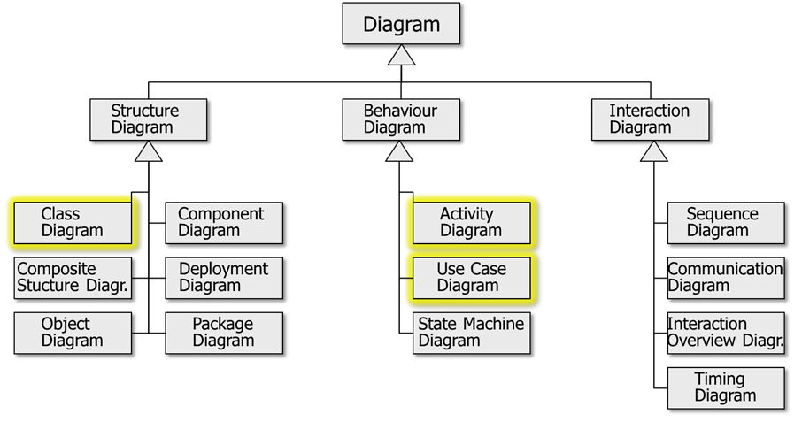
UML diagrams

Slide 4
Activity Diagrams

Slide 5
Activity Diagrams
Use Case Descriptions essential for the documentation of use cases
Contain dynamic elements
Communication with users
Use Case Diagrams are incomplete
No graphical representation of sequences
Activity diagrams: represent all activities, including conditional branches

Slide 6
Activity Diagrams
Used for a number of decades
Similar to Flow Charts or Petri Nets.
Model the content of use cases, workflows, business processes
Some of the intrinsic concepts include:
Actions
Conditions (if)
Repetition (while)
Fork (parallel)
Join (parallel activities are joined)
Readable (Communication)

Slide 7
Example: How to Build a House

Slide 8
Actions and Control Flow
start
All Activity Diagrams begin with a start node
An activity consists of several actions
A directed edge models the control flow
All Activity Diagrams must have a finish node
Action1
Action2
Action3
finish

Slide 9
Conditional Behaviour
Decision Node
Single incoming flow
Several guarded output flows
Guard: Boolean condition placed inside square brackets
[else] means all other conditions failed
Merge Node
Many incoming flows, one output flow
End of conditional behaviour
Action
[if]
[else]
Action
Action

Slide 10
Merge Nodes
Merge alternative flows
Kind of an ‘OR’: One single incoming action triggers the outgoing action

Slide 11
Decision and Merge Nodes

Slide 12
Parallel Activation: Fork
Fork: to model the possibility that two or more actions can run in parallel
At a fork, an action triggers several parallel actions
ParAction1
Action
ParAction2

Slide 13
Parallel Action: Join
Join: to draw together the actions running in parallel into one action
Kind of an ‘AND’: All incoming actions must be completed before flow continues!
ParAction1
Action
ParAction2

Slide 14
Parallel Action
Both the work on building site and the office work have to be finished before flow continues!

Slide 15
Join Specification
Join Specification: Boolean expression attached to a Join
Processing continues only when expression is true
A
Insert Coin
Dispense Drink
Select Drink
B
{join spec = A and B and
value of inserted coins >= price of selected drink}

Slide 16
Start Node
Only one start node
No incoming flow
start

Slide 17
Activity and Flow Final
Finish Node: Ends whole activity
Flow Final: Just ends one particular incoming flow (can be used for error or alternative cases)

Slide 18
Flow Final
Install
component
Build
component
[no more
components
to be built]
[more components
to be built]

Slide 19
Control Flow
This is not allowed:
This is OK:
X
X
Action
Action

Slide 20
Partitions
So far we know what happens
But who does what?
Divide activity diagram into partitions (swim lanes)
Guest
Waiter
Order food
Take order
Eat
Serve food

Slide 21
Signals
Time signal: occurs because of passing of time
Accept Signal: some external event occurred and we accept it (implies that the activity constantly listens)

Slide 22
Signals Example
2 hours before
flight
Pack bags
Leave
Taxi
arrives

Slide 23
Sending Signals, Time Outs
We can also send signals to other activities:
Time signals can be used to model time outs
Reserve
itinerary
Cancel
itinerary
Wait 48 hours
Send
itinerary
Intinerary
confirmed
Book
itinerary

Slide 24
Objects
Object nodes describe objects resp. resources
Gives you an idea about the process context of data
Actions may create objects as output parameter or take them as input parameter
Notes:
Example how data/objects are embedded in a process.

Slide 25
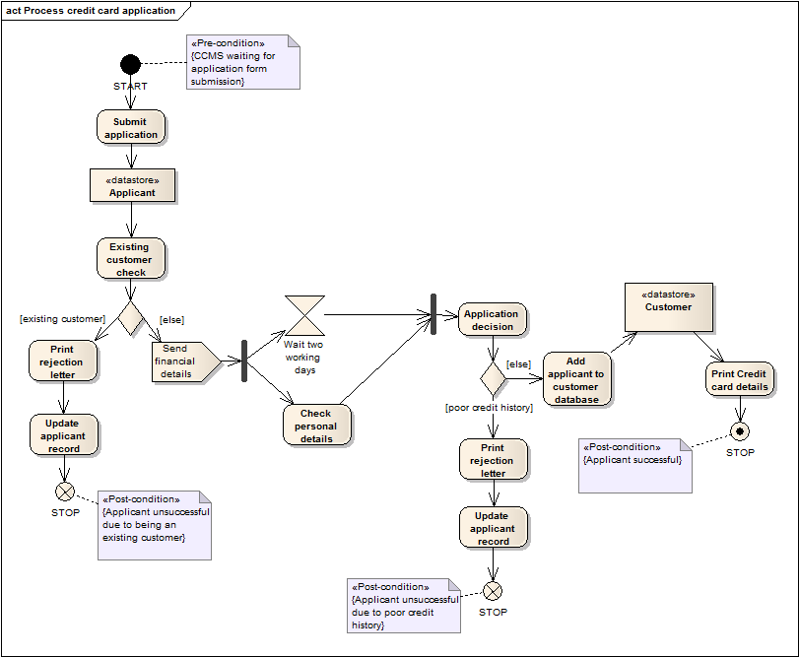
A full Example

Slide 26
Steps to develop Activity Diagrams
Finding system Actors, use cases
Identifying key scenarios of system use cases
Combining the scenarios to produce comprehensive workflows described using activity diagrams
Where significant object behaviour is triggered by a workflow, adding object flows to the diagrams
Where workflows cross technology boundaries, using swimlanes to map the activities
Refining complicated high level activities similarly, nested activity diagrams

Slide 27
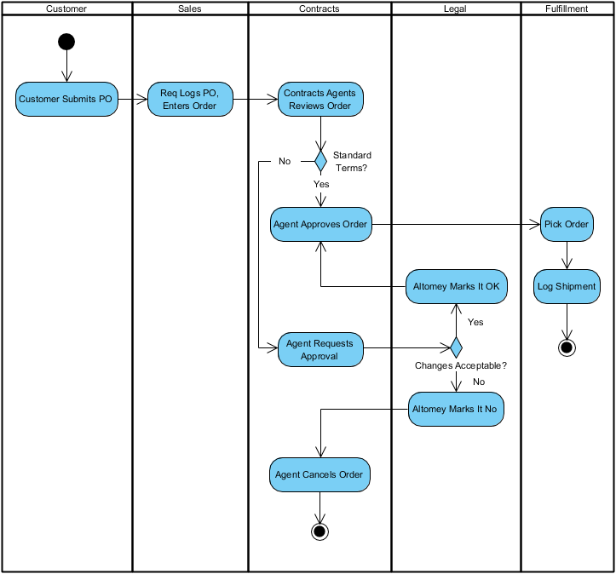
example

Slide 28
Homework

Slide 29
Some Homework
Some exercises for you to practice
Optional, but: please take this chance. Good UML is only achieved by practice, practice, practice!

Slide 30
Exercise 1
Given the following restaurant scenario,
Identify actors and use cases;
Draw a Use Case Diagram and activities diagram reflecting the scenario!
In a restaurant, a guest can order and then eat a meal. A waiter can take orders and deliver the bill. A guest can pay the bill either by credit card or cash. Credit card payment includes checking the credit card by a credit card company.

Slide 31
Exercise 2
Also please create an activity diagram for the Authenticate Use Case description presented at as follows

Slide 32
Authenticate Use Case
Main flow of events (success sequence)
The ATM prompts the card holder for the PIN
Card holder inputs PIN
ATM verifies PIN
ATM requests authorisation from an authorisation system
Authorisation system confirms authorisation
The ATM authorises the card holder

Slide 33
Authenticate Use Case
Alternative Sequence
A1: 1st or 2nd time wrong PIN (starts at point 4 of main flow)
ATM informs card holder that the PIN is incorrect for the 1st or 2nd time
The scenario goes back to point 1

Slide 34
Exercise 2
Also please create an activity diagram for the Authenticate Use Case description presented at the beginning of this lecture!

Slide 35
Authenticate Use Case
Main flow of events (success sequence)
The ATM prompts the card holder for the PIN
Card holder inputs PIN
ATM verifies PIN
ATM requests authorisation from an authorisation system
Authorisation system confirms authorisation
The ATM authorises the card holder

Slide 36
Authenticate Use Case
Alternative Sequence
A1: 1st or 2nd time wrong PIN (starts at point 4 of main flow)
ATM informs card holder that the PIN is incorrect for the 1st or 2nd time
The scenario goes back to point 1

Slide 37
Authenticate Activity Diagram
Prompt
Card Holder
PIN
inserted
Verify
PIN
Prompt
3rd Incorrect
PIN
[PIN wrong 1st
or 2nd time]
<<Pre-condition>>
Card inserted
Prompt
Incorrect
PIN
[PIN wrong
3rd time]
<<Post-condition>>
User not authenticated
[else]
Confiscate
Card
Request
Authorisation
<<Post-condition>>
User authenticated
[Auth.
OK]
[else]
Authorise
user
Receive
response
<<Post-condition>>
User not authenticated

